Slide 1

PHYSICAL FACTORS OF BUSINESS ON LOCATION “Winners are not people who never fail but people who never quite.”

Slide 2
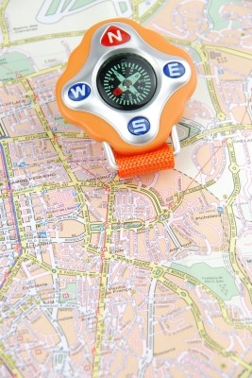

PHYSICAL FACTORS
BUSINESS ENVIRONMENT:
Business environment is a direct relationship between successful management and the influence and impact of environmental change.
Environmental factors can be both internal and external for the business.

Slide 3
INTERNAL FACTORS:
FACTOR AFFECTING INTERNAL BUSINESS ENVIRONMENT
Value system
Mission and objectives
Management structure and nature
Human Resources
Other factors
Physical assets and facilities
Financial resources
Marketing resources

Slide 4
EXTERNAL FACTOR:
MICRO FACTORS
Suppliers
Competitor
Market intermediaries
MACRO FACTORS
Economic factor
Technological factor
Legal factor

Slide 5
CONCLUSION
These factors have an important impact on business.
The internal environment will reveal its strengths and weaknesses.
The external environment will reflect the opportunities available to the organization and the threats it faces.

Slide 6


PHYSICAL FACTORS
SELECTION OF BUSINESS LOCATION IN PAKISTAN
Being in the right location is a key ingredient in a business’s success.
It is a big commitment and may take time to find the perfect spot.
FACTORS AFFECTING ON BUSINESS LOCATION
RAW MATERIAL:
If your business is not close to raw material then it will reduce your profit margin.

Slide 7
2. TRANSPORT COST:
It includes the cost of getting inputs in to the business and also the cost of getting products delivered to customers.
3. LOCATION OF COMPETITORS:
A business location near the competitors is often advantageous because buyers already attracted to the area but it is also disadvantage because customers are attracted by the best quality and cheap price of product.
4. MARKET:
For the rapid collection of raw material it is necessary the market should be near the business location.

Slide 8
5. POPULATION AND STYLE:
The nature and type of persons living in an area to whom goods are to be supplied, will influence the location of an industry.
6. LABOUR COST:
In an agricultural country the location must be selected in the area where skilled labour can easily be had. The cost of labour is another important factor in selecting a business location.

Slide 9


PHYSICAL FACTORS
FACTORS INFLUENCING BUSINESS LOCATION
Location decisions, once made, are difficult and costly to undo.
The costs of moving an operation are often significant and run the risk of inconveniencing customers and staff.
It is always best to get the location decision right first time.

Slide 10
MAIN FACTORS INFLUENCING CHOICE OF BUSINESS LOCATION
The costs of the operation.
The customer service that the business wants to provide.
The potential revenues that can be achieved from the location.
1. LAND COST:
The land will be purchased, but more often it will be rented.
Rentals can vary enormously depending on the location and the facilities provided.

Slide 11
2. ENERGY COSTS:
Some businesses use substantial amounts of energy.
They should be able to negotiate a good price for their energy needs regardless of location in the Pakistan.
3. COMMUNITY FACTORS:
Local government attitude to supporting business (including financial assistance)
Language
Political stability
4. CUSTOMER CONVENIENCE:
Businesses need to be located where customers find it quick, easy and cheap to access the service being provided.

Slide 12


PHYSICAL FACTORS
DIFFERENCE OF SMES AND LARGE SCALE INDUSTRIES
BIG COMPANIES:
Decisions approval processes.
Things move slowly.
SMALL COMPANIES:
Decisions approved quickly.
Things move much quicker.

Slide 13
SMALL BUSINESS | LARGE BUSINESS
Generally fewer than 100 employees. | Usually has more than 500 employees.
Less numbers of persons and capital. | Large number of persons and capital.
Work is done by man power and tools. | Work is done by huge machines and labours.
Less use of raw material and less number of production(consequently). | Large use of raw material and huge number of production.
Owner manage | Professional management
Generalized | Specialized
Direct chain of command. | Change of command with multiple levels.
Example: Cycle, toys etc. | Example: cotton industry, textile industry etc.

Slide 14
LOCATION SELECTING FOR SMALL AND LARGE SCALE BUSINESS
SMALL SCALE:
Raw Materials
Demographics / Psychographics (Individual Mindset And Beliefs)
Availability Of Basic Infrastructures
Government Economic Policy
LARGE SCALE:
Raw Material
Transport
Market
Government Policies

Slide 15
CONCLUSION:
Locational factors are very important and must be considered when setting up a business so, as to have a blossom growth.

Slide 16


PHYSICAL FACTORS
PURCHASING INVENTORY
Production of merchandises for the promotion of product. E.g. Furniture's and fixtures, raw materials, tool and Equipment, Machinery, Supplier etc.
Comparison of product with the product of the competitor.

Slide 17
ORGANIZATIONAL STRUCTURE OF PURCHASING DEPARTMENT:
Purchasing department is a staff function in the overall company structure.
Line basis purchasing department.
Purchasing manager is responsible for the overall efficient operation of the department.
Purchasing manager has the powers to execute purchasing contract for the concern.

Slide 18
ORGANIZATION O1F PURCHASING DEPARTMENT:
Size and nature of business concerns
Large volume of purchases
Small volume of purchases
CENTRALIZED PURCHASING:
Control on buying is exercised effectively.
Better terms on purchase are possible.
Purchasing specialization is obtained
Skills of the purchasing officer are high.

Slide 19
DECENTRALIZED PURCHASING:
Effective control is not possible.
Bargaining power is very low.
Purchasing specialization is not obtained.
Purchasing skill is available from the purchaser or purchasing officer.

Slide 20

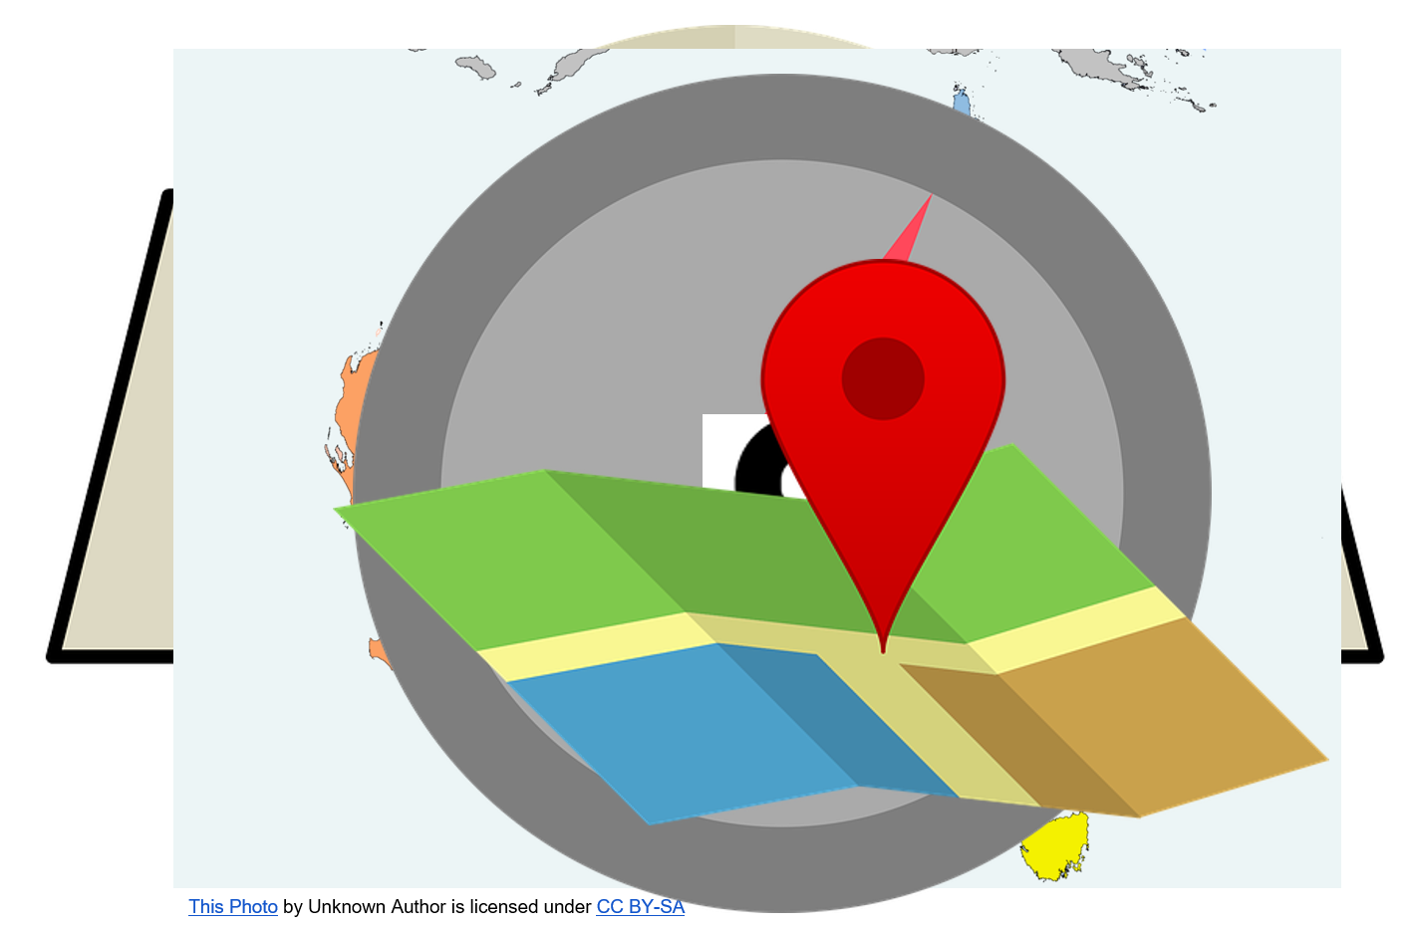
PHYSICAL FACTORS
PURCHASING POLICIES
Buying refers to obtaining goods and services in exchange for money or barter . The successful buying is the combination of the following:
Right price
Right quantity
Right quality
Right time right supply sources

Slide 21
Companies follows different purchasing polices suited to their needs. The following policies which are as under:
SPECULATIVE PURCHASING:
1. Purchase made for internal consumption but , to relate a later date for profit.
Example: fuels for air line commodity for estate developers.
HAND TO MOUTH PURCHASING:
1. Item are purchased only there is demand for those items.
2. Item are purchase so that the immediate requirement can be met.
FORWARD PURCHASING
1. Buying in advance when the price is low.
2. Minimize risk of raising material cost and protection against future.

Slide 22
CONTRACT PURCHASING:
1. It is an agreement between the buyer and the seller.
2. It is a confidence buying
RECIPROCAL BUYING:
1. Reciprocal buying occur when a customer agree to buy from a supplier only if that suppliers agree to purchase something from customer
SINGLE VERSUS SEVERAL VENDORS:
1. Buy from a single fixed sources entails many Dangers.
2. On the other hand buying from several sources is safe.

Slide 23
SUMMARY
Purchasing is a technical, difficult and fussy function.
The purchasing agent should be expert .
He should not depend only one source of supply.

Slide 24

THANKS!

